Slide 1
Services
Corrosion control services
Aries Corrosion Control & Management services is molded out by a group of
corrosion experts to deliver prompt solutions for extending the life of structural
elements, metal/non-metal, doctored by proper analysis and treatment.
Offshore/Marine structures are built irrespective of the atmospheric conditions
to which they are exposed. Hence, proper coating procedure is crucial for any
offshore/marine structure for preserving and maintaining it as good as new.
This relies on procedures which include proper surface treatment techniques,
required coating materials and methods of applications.

Slide 2
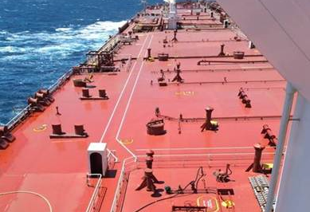
Services
Ballast Tanks Maintenance Program
Deck Maintenance Program
Accommodation Maintenance Program
Pipeline Cleaning Program
HVAC/Insulation and Cladding
Cargo Hold Maintenance
Cleaning Jobs Ballast tank Mud cleaning
Riding Squad
Hydro Jetting Services
Abrasive blasting and painting
Helideck Maintenance

Slide 3
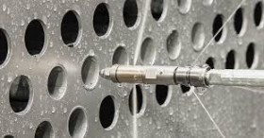
Services
Riding Squad
Hydro Jetting Services
Abrasive blasting and painting
Helideck Maintenance
Surface preparation
Exchanger & condenser tubes
Internal and external coatings removal
Drill pipe cleaning
Lancing of Pipelines and Grey Water Lines at Offshore Rig
Drain Line Cleaning at Shipyards
Internal Cleaning of Tube Line
Industrial blasting & Coatings-Drilling handling tools,
Containers, Pipelines, Racks, skids, Bolts, Flanges,
Pressure vessels etc.
Pipeline internal blasting and coating
Silo tank cleaning & refurbishment

Slide 4
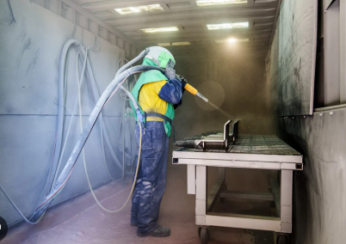
Services
Riding Squad
Hydro Jetting Services
Abrasive blasting and painting
Helideck Maintenance
Industrial blasting & Coatings-Drilling handling tools,
Containers, Pipelines, Racks, skids, Bolts, Flanges,
Pressure vessels etc.
Pipeline internal blasting and coating
Silo tank cleaning & refurbishment

Slide 5
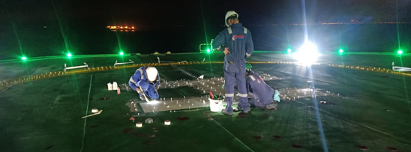
Services
Riding Squad
Hydro Jetting Services
Abrasive blasting and painting
Helideck Maintenance
Aries has well-experienced offshore and onshore teams to
perform coating maintenance on different types of helidecks including Aluminium to comply with CAP 437 regulations.

